Slide 1
Topics of this course
What is CS ?
Lect 1: what is computer
Lect 2: how is computer system working
Lect 3: Turing machine & P vs NP
Why is CS so hot ?
How to learn CS ?

Slide 2
Lecture 3：Turing Machine & P vs NP
qiang@suda.edu.cn

Slide 3
S24 game: conduct an exp with (+-*/)=24
3 3 3 3
4 4 4 4
5 5 5 5
6 6 6 6
4 4 10 10
3 3 8 8
3 3 7 7
Is it because we are not smart enough for the last question?

Slide 4

Can this car turn around on the road?

Slide 5
The moral of the above video
If you have checked this video, you know it can be done. So, you can do it with 100% confidence.
However, if you have not seen this video before, putting yourself in such a narrow road, you are not sure if you can make this U-turn.
Maybe you chose to back up your car :-)

Slide 6
More important question than how to do
Is it able to be done? (before starting it)
A correct direction is more important than hard working.

Slide 7
Similar question for computer-solving diagram:
Is it able to be done by computer?
If yes, just do it.
If you are not able to solve it, you are not smart enough☺
If no, find alternatives.
Do not waste your time.
Find approximations ……
But wait a minute, how (who) to judge “to be or not to be”?

Slide 8
Why need TM?
Given a problem and its computational solver, can an analytical conclusion of the solver performed on a specific ‘computer’ be generalized to any other computers?
TM provides a unified reference model for all kinds of different computers. Any conclusions drawn from TM shall be applied to ALL computers.
Theoretical computation

Slide 9
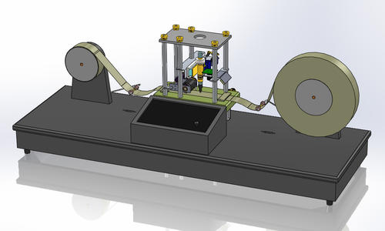
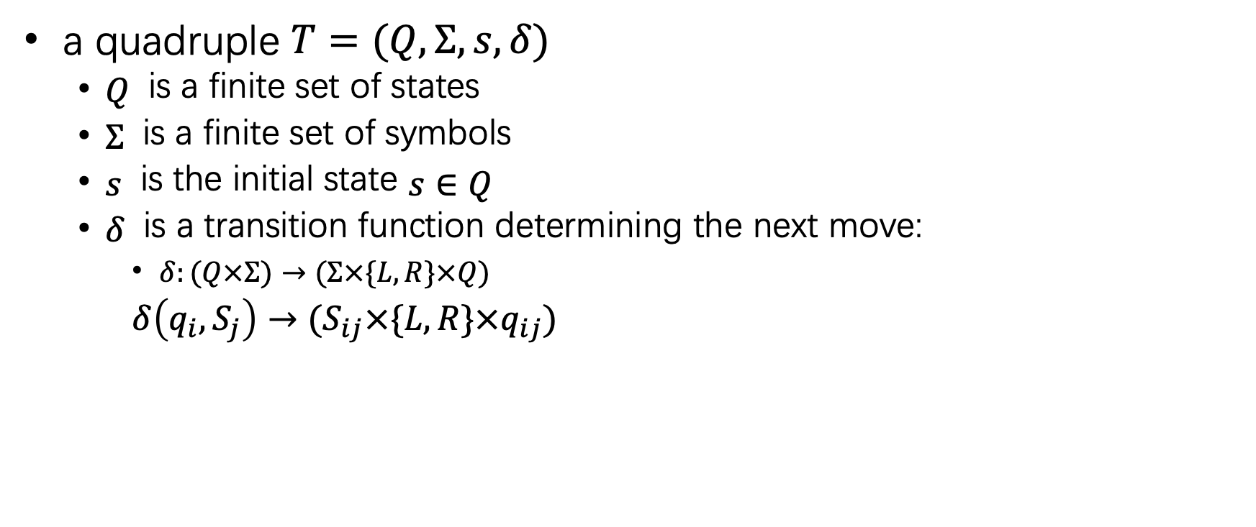
What is Turing machine: formulized version
a quadruple $T=(Q,Σ,s,δ)$
$Q$ is a finite set of states
$Σ$ is a finite set of symbols
$s$ is the initial state $s∈Q$
$δ$ is a transition function determining the next move:
$δ:(Q×Σ)→(Σ×\{L,R\}×Q)$
$δ\left(q_{i},S_{j}\right)→(S_{ij}×\{L,R\}×q_{ij})$

Slide 10
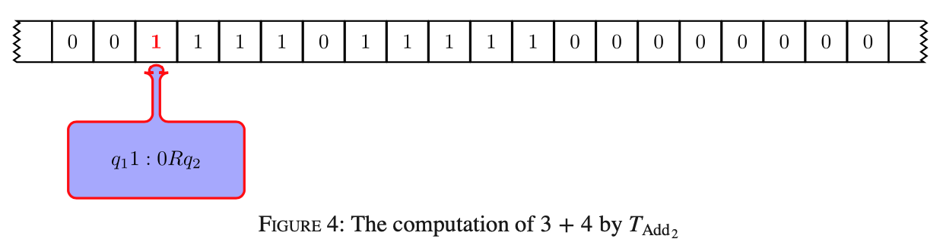
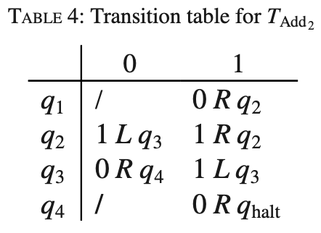

Turing machine: a sample $T_{+2}$
represent the number n as a block of n+1 copies of the symbol ‘1’on the tape.
Thus we will represent the number 0 as a single ‘1’ and the number 3 as a block of four ‘1’s.
This is called unary notation.
Two addends is separated with a 0.
0
0
1
q40Rqhalt
Notes:
把第一个1翻转为0，直接遇到第一个间隔0，翻其为1，开始遇1后退，退到第一个0（实际上是第一个加数的1，被翻胃0）后停止后退，向前遇到第一个1（实际上是第一个加数的第二个1）翻0，停机。完整过程实际上是灭掉第一个加数的前两个1，把间隔0改为1.

Slide 11
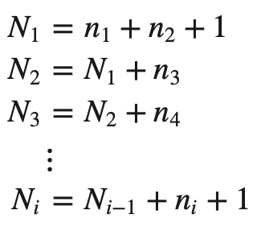
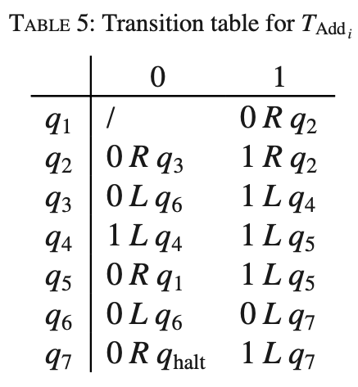

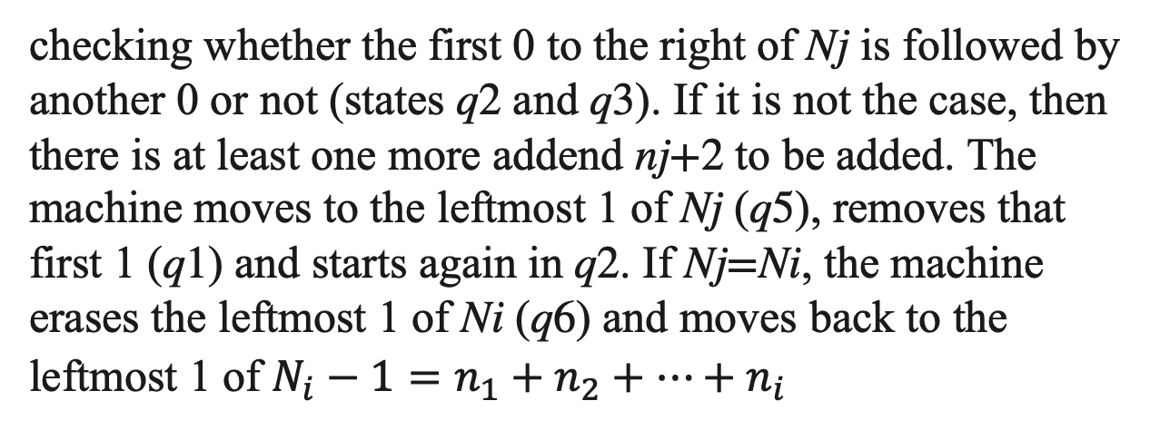
Turing machine: generalized $T_{+i}$
checking whether the first 0 to the right of Nj is followed by another 0 or not (states q2 and q3). If it is not the case, then there is at least one more addend nj+2 to be added. The machine moves to the leftmost 1 of Nj (q5), removes that first 1 (q1) and starts again in q2. If Nj=Ni, the machine erases the leftmost 1 of Ni (q6) and moves back to the leftmost 1 of $N_{i}−1=n_{1}+n_{2}+…+n_{i}$
Notes:
第一个1翻0，扫面所有1，直到遇0(q3)，开始向左退

Slide 12
1:1L
5
0:0R
1:1L
1
2
3
4
0:1L
1:0R
0:0R
1:1L
0:0L
1:1R
6
7
h
0:/
1:0L
0:0R
0:0L
1:1L

Slide 13
1 | 1 | 0 | 1 | 1 | 0 | 1 | 1 | 1 | 0
1:1L
5
0:0R
1:1L
1
2
3
4
0:1L
1:0R
0:0R
1:1L
0:0L
1:1R
6
7
h
0:/
1:0L
0:0R
0:0L
1:1L

Slide 14
0 | 1 | 0 | 1 | 1 | 0 | 1 | 1 | 1 | 0
1:1L
5
0:0R
1:1L
1
2
3
4
0:1L
1:0R
0:0R
1:1L
0:0L
1:1R
6
7
h
0:/
1:0L
0:0R
0:0L
1:1L

Slide 15
0 | 1 | 0 | 1 | 1 | 0 | 1 | 1 | 1 | 0
1:1L
5
0:0R
1:1L
1
2
3
4
0:1L
1:0R
0:0R
1:1L
0:0L
1:1R
6
7
h
0:/
1:0L
0:0R
0:0L
1:1L

Slide 16
0 | 1 | 0 | 1 | 1 | 0 | 1 | 1 | 1 | 0
1:1L
5
0:0R
1:1L
1
2
3
4
0:1L
1:0R
0:0R
1:1L
0:0L
1:1R
6
7
h
0:/
1:0L
0:0R
0:0L
1:1L

Slide 17
0 | 1 | 0 | 1 | 1 | 0 | 1 | 1 | 1 | 0
1:1L
5
0:0R
1:1L
1
2
3
4
0:1L
1:0R
0:0R
1:1L
0:0L
1:1R
6
7
h
0:/
1:0L
0:0R
0:0L
1:1L

Slide 18
0 | 1 | 1 | 1 | 1 | 0 | 1 | 1 | 1 | 0
1:1L
5
0:0R
1:1L
1
2
3
4
0:1L
1:0R
0:0R
1:1L
0:0L
1:1R
6
7
h
0:/
1:0L
0:0R
0:0L
1:1L

Slide 19
0 | 1 | 1 | 1 | 1 | 0 | 1 | 1 | 1 | 0
1:1L
5
0:0R
1:1L
1
2
3
4
0:1L
1:0R
0:0R
1:1L
0:0L
1:1R
6
7
h
0:/
1:0L
0:0R
0:0L
1:1L

Slide 20
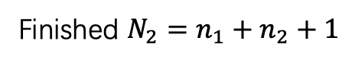
0 | 1 | 1 | 1 | 1 | 0 | 1 | 1 | 1 | 0
1:1L
Finished ${N_{2}=n}_{1}+n_{2}+1$
5
0:0R
1:1L
1
2
3
4
0:1L
1:0R
0:0R
1:1L
0:0L
1:1R
6
7
h
0:/
1:0L
0:0R
0:0L
1:1L

Slide 21
0 | 1 | 1 | 1 | 1 | 0 | 1 | 1 | 1 | 0
1:1L
5
0:0R
1:1L
1
2
3
4
0:1L
1:0R
0:0R
1:1L
0:0L
1:1R
6
7
h
0:/
1:0L
0:0R
0:0L
1:1L

Slide 22
0 | 1 | 1 | 1 | 1 | 0 | 1 | 1 | 1 | 0
1:1L
5
0:0R
1:1L
1
2
3
4
0:1L
1:0R
0:0R
1:1L
0:0L
1:1R
6
7
h
0:/
1:0L
0:0R
0:0L
1:1L

Slide 23
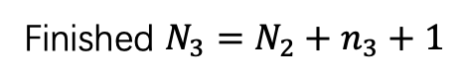
0 | 0 | 1 | 1 | 1 | 1 | 1 | 1 | 1 | 0
1:1L
Finished ${N_{3}=N_{2}+n}_{3}+1$
5
0:0R
1:1L
1
2
3
4
0:1L
1:0R
0:0R
1:1L
0:0L
1:1R
6
7
h
0:/
1:0L
0:0R
0:0L
1:1L

Slide 24
0 | 0 | 1 | 1 | 1 | 1 | 1 | 1 | 1 | 0 | 0
1:1L
5
0:0R
1:1L
1
2
3
4
0:1L
1:0R
0:0R
1:1L
0:0L
1:1R
6
7
h
0:/
1:0L
0:0R
0:0L
1:1L

Slide 25
0 | 0 | 1 | 1 | 1 | 1 | 1 | 1 | 1 | 0 | 0
1:1L
5
0:0R
1:1L
1
2
3
4
0:1L
1:0R
0:0R
1:1L
0:0L
1:1R
6
7
h
0:/
1:0L
0:0R
0:0L
1:1L

Slide 26
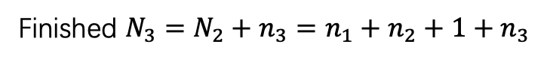
0 | 0 | 1 | 1 | 1 | 1 | 1 | 1 | 0 | 0 | 0
1:1L
Finished ${N_{3}=N_{2}+n}_{3}=n_{1}+n_{2}+1+n_{3}$
5
0:0R
1:1L
1
2
3
4
0:1L
1:0R
0:0R
1:1L
0:0L
1:1R
6
7
h
0:/
1:0L
0:0R
0:0L
1:1L

Slide 27
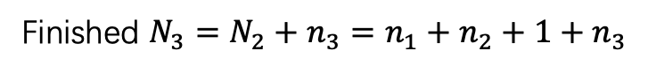
0 | 0 | 1 | 1 | 1 | 1 | 1 | 1 | 0 | 0 | 0
1:1L
Finished ${N_{3}=N_{2}+n}_{3}=n_{1}+n_{2}+1+n_{3}$
5
0:0R
1:1L
1
2
3
4
0:1L
1:0R
0:0R
1:1L
0:0L
1:1R
6
7
h
0:/
1:0L
0:0R
0:0L
1:1L

Slide 28
Such a TM can be built by conducting a digital circuit
1:1L
5
0:0R
1:1L
1
2
3
4
0:1L
1:0R
0:0R
1:1L
0:0L
1:1R
6
7
h
0:/
1:0L
0:0R
0:0L
1:1L

Slide 29
Impact of TM on CS
Impact on Theoretical Computer Science
TM and the Modern Computer
Theories of Programming

Slide 30
Impact on Theoretical Computer Science
What is an algorithm?
What is a computation?
What is a physical computation?
What is an efficient computation?
etc.

Slide 31
How to define “computer can do it”?
P (computer can do it)
solve on deterministic (TM) with Polynomial time
NP (computer cannot do it)
Solve on Non-deterministic (TM) with Polynomial time
Can be verified in P
1:1L
Multiple states for the same input
5
1:0L
0:0R
1
2
3
1:0R
0:0R
1:1L
0:0L
1:1R

Slide 32
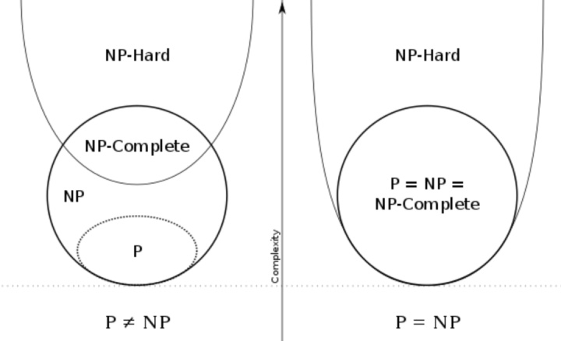
NP catalog
NP-hard
ALL other NPs can be P-converted to it
harder than NP, but not necessary NP
NP-complete
NP-hard & NP

Slide 33
P example
Verify 8 / ( 3- 8/3) = 24
Find the maximum among (1,2,3,……, n)

Slide 34
NP-C example
SAT
General version of “S24 game”

Slide 35
NP-H example
Halting problem
Undecidable, so not in NP

Slide 36

The century challenge:
P = (≠) NP ?
Any boy and girl want to challenge it?
Applauds!

Slide 37
Key idea of this lecture
Computability is a big question !

Slide 38
Homework 3
Program to solve “S24”game.

